Slide 1
Traffic Management Techniques
KIET Group Of Institutions
HACKATHON 2019

Slide 2
Losses due to traffic congestion
Wasting time of passengers.
Fuel loss
Loss of life due to not reaching on time.
Increased road accidents due to over speed taken to make up the lost time.

Slide 3
Adaptive traffic lights
When new signal times are implemented congestion of the road are also considered.
By measuring the real time congestion level signal times are updated.
Sensors would be deployed on roads for bmeasuring the conditions.
Sensors will measure congestion data and transfer it to cloud.
Programs running in the cloud could figure out the optimal signals.
Then highly congested road would not have longer waiting time.

Slide 4
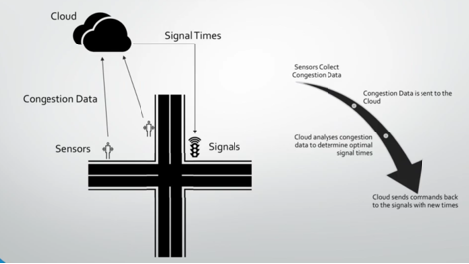

Slide 5
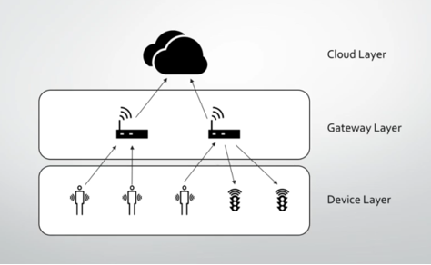

Slide 6
Existing System:
It is difficult to identify the traffic violators.
There is no IOT based traffic management system.

Slide 7
Proposed System:
IOT based traffic management.
Easy to find the path for ambulance in emergency conditions.
The traffic violators could be captured and sent to police.

Slide 8
Advantages:
Can be used anywhere.
No need of human power to identify violators during night.

